Slide 1
Progressive Web Applications
Presented By:
Siddhartha Shakya
BIM (B)

Slide 2
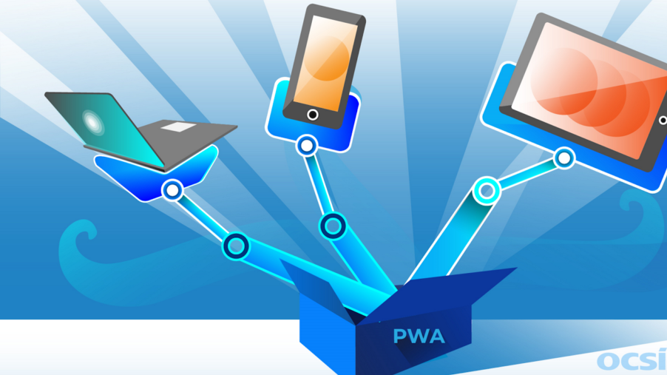
What is a PWA?
A progressive web app (PWA) is an app that's built using web platform technologies, but that provides a user experience like that of a mobile app.

Slide 3
Key Features of PWAs
Responsive: Works on any device with a screen and a browser.
Offline Capabilities: Some PWAs can work offline or on low-quality networks.
App-like Interface: Feels like an app to the user with app-style interactions and navigation
Fresh: Always up-to-date due to the service worker update process.
Discoverable: Can be found by search engines.

Slide 4
Advantages of PWAs
Cost-Effective: One codebase for all platforms.
Improved Performance: Faster load times and better user experience.
Easy Installation: No app store required, can be installed directly from the browser.
Offline Access: Some PWAs offer offline capabilities

Slide 5
Examples of PWAs
Twitter Lite: Offers fast performance and a small footprint.
Pinterest: Improved user engagement and time spent on the site.
Starbucks: Offline capabilities and improved performance.
Uber: Lightweight and works well on slow networks.

Slide 6
How To Access PWA?
To access PWA, follow the steps given below:
Open your web browser. (Eg: Google Chrome, Brave, Microsoft Edge or other modern web browsers)
Let’s take twitter lite as an example. Type ‘mobile.twitter.com’ into the browser's address bar and press Enter.
When you visit Twitter Lite, you may see a prompt at the bottom of the screen saying "Add Twitter to Home screen." Click this prompt.
Alternatively, tap the three-dot menu icon in the top-right corner of Chrome and select "Add to Home screen.” or there may be “Install this app”
Note: Not every web app that can be added to your home screen is a PWA. They should fulfill some criterias before they can be considered PWA.

Slide 7
Conclusion
Progressive Web Applications represent the future of web development by combining the best of web and mobile apps. They provide an enhanced user experience, better performance, and a cost-effective solution for developers.

